Slide 1

CMPG 213 GROUP 11 Requirements Document

Slide 2
Group 11 members
Christiaan Visagie, 37332287
Innocent Ndelema, 35981326
Leon Mostert, 20805330
Pearl Makhafola, 31453600

Slide 3
Table of contents
Project plan
Definitions, acronyms and abbreviations
Project description and scope
Functional requirements
Business data requirements (inputs, outputs)
Business processes requirements
Business interface requirements
Non-functional requirements
Candidate systems matrix
Feasibility analysis matrix
Use-case glossary & use-case model diagram
Examples of data, questionnaires and fact-finding techniques used
Summary, future and further planning

Slide 4
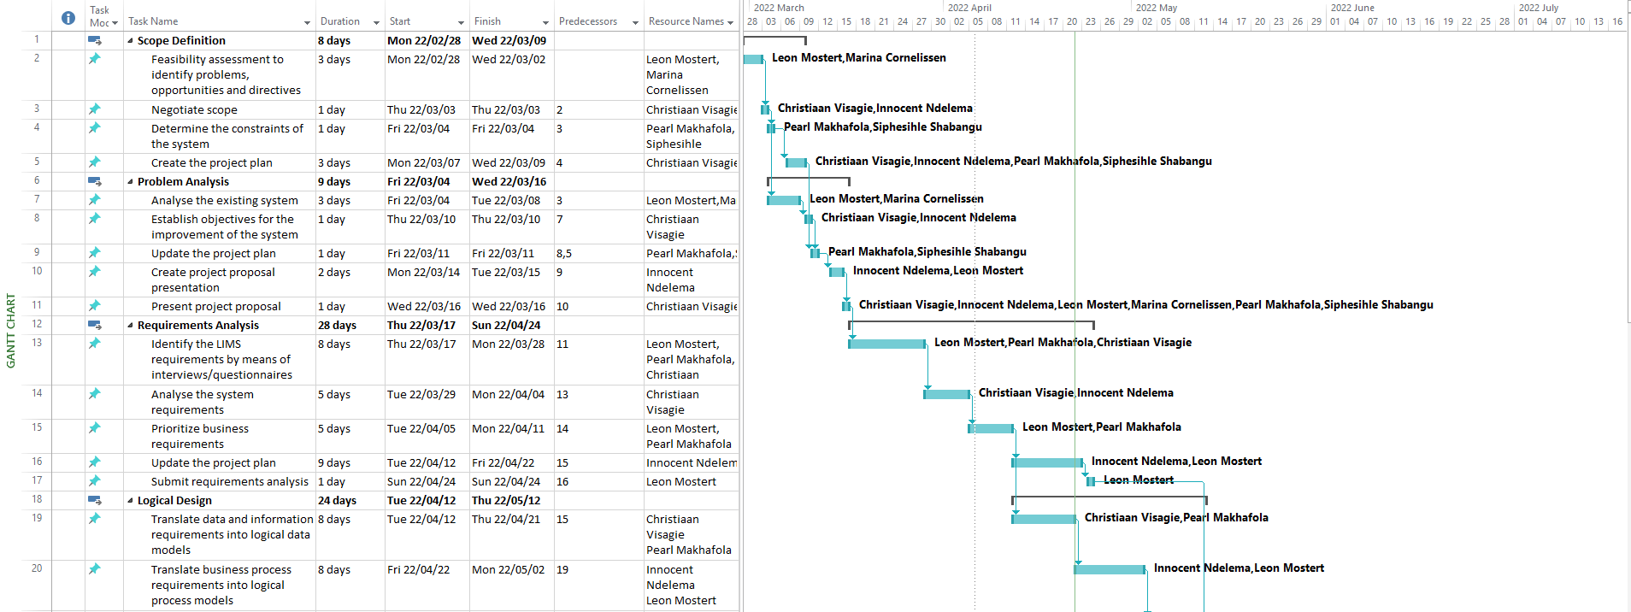
1. Project plan

Slide 5
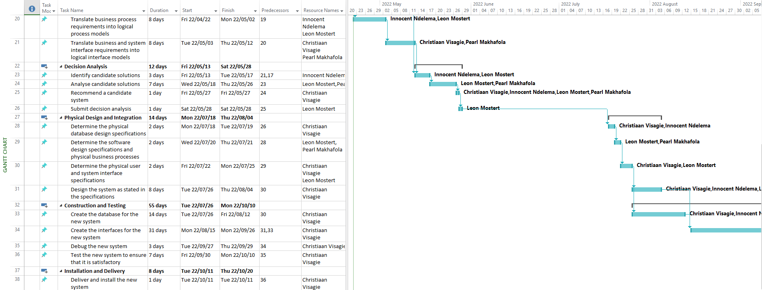
1. Project plan (continued)

Slide 6
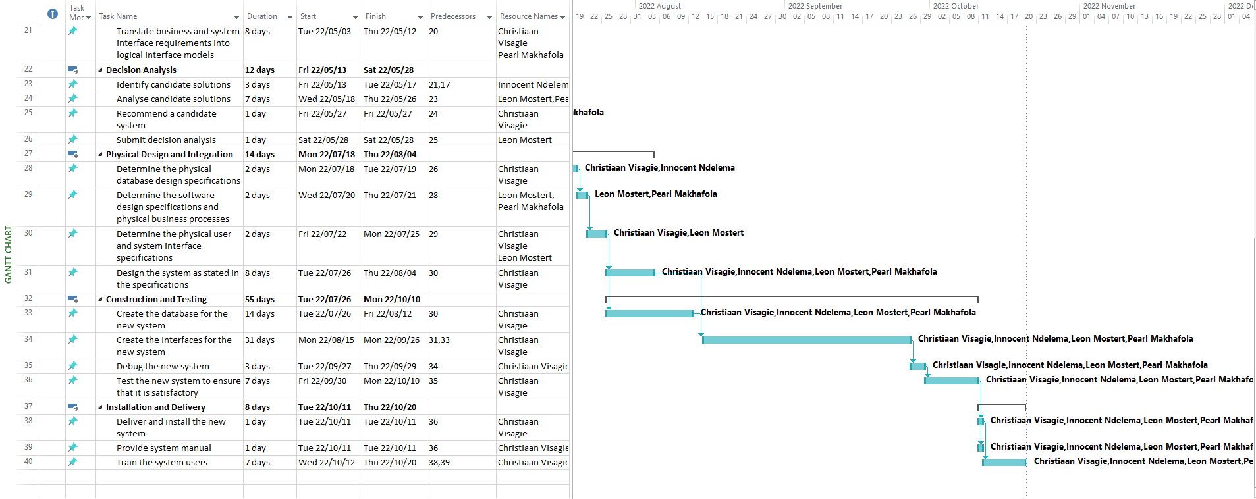
1. Project plan (continued)

Slide 7
2. Definitions, acronyms and abbreviations
Abbreviations
LIMS: Laboratory Integrated Management System
PERT Chart: Program Evaluation Review Technique Chart
COTS: Commercial Off-The-Shelf
FAST: Framework for the Application of Systems Thinking
Definitions
GANTT Chart: A bar chart that is used to depict project tasks against a schedule. The tasks are placed on the vertical axis and the time is placed on the horizontal axis.
PERT Chart: A graphical network model that depicts the interdependencies between project tasks, used to schedule and coordinate tasks within a project.

Slide 8
3. Project Description and Scope
UIS Analytical Services is a SANAS accredited, ISO/IEC 17025 compliant testing laboratory in South Africa. The laboratory performs analytical tests on a wide variety of sample types and matrices such as soils, minerals, ores (base, ferrous and Platinum Group Metals (PGMs)), metals and coal/ash. Clients that make use of the laboratory’s analytical services consist of mines, metallurgical plants, power stations and mineral export services, from which it is typically geologists, process engineers and export coordinators that interact with the staff at the laboratory.
Analytical samples are submitted to the laboratory by the clients. The samples are logged as part of a work request by assigning the desired analysis and designating a responsible person for the analysis. After the work request is completed, it is invoiced. Once payment from clients have been received, the payment is allocated to the respective invoice.
The objective of this project is to provide UIS Analytical Services with an automated system (LIMS) to help with daily business processes and functions, as well as provide valuable information through extensive reporting to support business decisions. The system will also have database backup functionality, provide/deny access by means of usernames and passwords, and provide elevated functionality to administrator users. Before implementation of the new system, historic data on the current system need to be transferred to the new system. The system will be developed and implemented using the FAST methodology. The scope of the system will include the following functionality:

Slide 9
3. Project Description and Scope (Continued)
The system must be able to perform the following functional requirements:
Maintenance of staff
Maintenance of clients
Maintenance of work requests
Generating of invoices
Receiving of payments
Backup of data
Extensive reporting, including financial statements, outstanding invoices, history of payments per period, and work in progress.

Slide 10
3. Project Description and Scope (Continued)
The system must satisfy the following non-functional requirements:
Provide secure access control to the system by use of unique usernames and passwords.
The database will be able to hold data for approximately 1500 work requests, 160 clients and 240 staff members.
Queries on the database should not take longer than 5 seconds.
The system should be able to provide different levels of access for general users and administrators, where the former has limited access and the latter full access.
Extensive help functionality will be available.

Slide 11
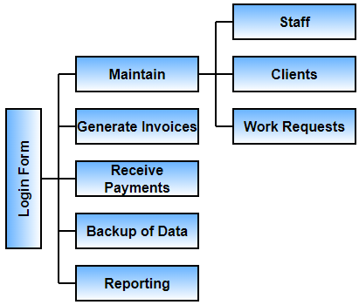
4. Graphical user interface requirements

Slide 12
4. Functional data, processes and interface requirements
Maintenance of Staff
Add new Staff
Input Data | Processing | Output
First Name Last Name ID Number Contact Number Pay rate Position Competent Tests; multiple tests can be selected (select Tests from list) | If an existing Staff member has the same ID Number, give a warning message Validate that: All attributes have been entered The ID Number is numerical and the correct length Contact Number is numeric and the correct length The Pay Rate is a positive, numerical value After the user clicked on the Create button, and no similar Staff member already exists, generate an Employee Number, and save the details of the new Staff member to the Staff database table | Warning message if Staff member with the same ID Number already exists Warning message if all attributes have not been entered Warning message if: The ID Number is invalid The Contact Number is invalid The Pay Rate is invalid Message, including the Employee Number, confirming that the new Staff member has been successfully added

Slide 13
4. Functional data, processes and interface requirements (continued)
Maintenance of Staff
Change details of existing Staff
Input Data | Processing | Output
Select Staff member from list (using Employee Number or Last Name) First Name Last Name ID Number Contact Number Pay Rate Position Competent Tests (select tests from list) – multiple can be selected | Display all attributes of selected Staff member and allow user to change Employee Number cannot be changed If another existing Staff member has the same ID Number, give a warning message Validate that All attributes have been entered The ID Number is numerical and the correct length Contact Number is numeric and the correct length The Pay Rate is a positive, numerical value After the user clicked on the Update button, and no similar Staff member already exists, save the details of the updated Staff member to the Staff database table | Warning message if another Staff member with the same ID Number already exists Warning message if all attributes have not been entered Warning message if: The ID Number is invalid The Contact Number is invalid The Pay Rate is invalid Message, including the Employee Number, confirming that the Staff member has been successfully updated

Slide 14
4. Functional data, processes and interface requirements (continued)
Maintenance of Staff
Delete existing Staff
Input Data | Processing | Output
Select Staff member from list (using Employee Number or Last Name) | Display all attributes of selected Staff member Verify that the user is logged in as an Administrator After the user clicked on the Delete button, and the user is logged in as an Administrator, remove the Staff member from the Staff database table | Warning message if user is not logged in as an Administrator A prompt to ask the user for confirmation to delete selected Staff member Message, including the Employee Number, confirming that the Staff member has been successfully deleted

Slide 15
4. Functional data, processes and interface requirements (continued)
Maintenance of Clients
Add new Client
Input Data | Processing | Output
Company Name Billing Address Contact Name Contact Number Payment Terms (select from list) | If an existing Client has the same Company Name, give a warning message Validate that All attributes have been entered Contact Number is numeric and the correct length After the user clicked on the Create button, and no similar Client already exists, save the details of the new Client to the Clients database table | Warning message if Client with the same Company Name already exists Warning message if all attributes have not been entered Warning message if the Contact Number is invalid Message, including the Company Name, confirming that the new Client has been successfully added

Slide 16
4. Functional data, processes and interface requirements (continued)
Maintenance of Clients
Change details of existing Client
Input Data | Processing | Output
Select Client from list (using Company Name) Company Name Billing Address Contact Name Contact Number Payment Terms (select from list) | Display all attributes of selected Client and allow user to change If another existing Client has the same Company Name, give a warning message Validate that All attributes have been entered Contact Number is numeric and the correct length After the user clicked on the Update button, and no similar Client already exists, save the details of the updated Client to the Clients database table | Warning message if another Client with the same Company Name already exists Warning message if all attributes have not been entered Warning message if the Contact Number is invalid Message, including the Client Name, confirming that the Client has been successfully updated

Slide 17
4. Functional data, processes and interface requirements (continued)
Maintenance of Clients
Delete existing Client
Input Data | Processing | Output
Select Client from list (using Company Name) | Display all attributes of selected Client Verify that the user is logged in as an Administrator After the user clicked on the Delete button, and the user is logged in as an Administrator, remove the Client from the Clients database table | Warning message if user is not logged in as an Administrator A prompt to ask the user for confirmation to delete selected Client Message, including the Company Name, confirming that the Client has been successfully deleted

Slide 18
4. Functional data, processes and interface requirements (continued)
Maintenance of Work Requests
Add new Work Request
Input Data | Processing | Output
Select Client from list (using Company Name) Analytical Tests; multiple tests can be selected (select Tests from list) Quantity per each test Select Responsible Person (using Employee Number or Last Name) Select Due Date | Validate that All attributes have been entered The Quantity values are all positive, integer values After the user clicked on the Create button, generate a Request Number, and save the details of the new Work Request to the Work Requests database table | Warning message if all attributes have not been entered Warning message if a Quantity value is invalid Message, including the generated Request Number, confirming that the new Work Request has been successfully added A copy of the generated Work Request is displayed – can be printed as a hard copy

Slide 19
4. Functional data, processes and interface requirements (continued)
Maintenance of Work Requests
Change details of existing Work Request
Input Data | Processing | Output
Select Work Request from list (using Request Number) Analytical Tests (select tests from list) – multiple can be selected Quantity per each test Select Responsible Person (using Employee Number or Last Name) Select Due Date | Display all attributes of selected Work Request and allow user to change Request Number cannot be changed Validate that All attributes have been entered The Quantity values are all positive, integer values Verify that the Work Request has not been invoiced/archived After the user clicked on the Update button, and the Work Request has not been invoiced/archived, save the details of the updated Work Request to the Work Requests database table | Warning message if all attributes have not been entered Warning message if a Quantity value is invalid Warning message if the Work Request has already been invoiced/archived Message, including the existing Request Number, confirming that the Work Request has been successfully updated

Slide 20
4. Functional data, processes and interface requirements (continued)
Maintenance of Work Requests
Archiving existing Work Request
Input Data | Processing | Output
Select Work Request from list (using Request Number) | Display all attributes of selected Work Request Verify that the Work Request has not been invoiced/archived Verify that the user is logged in as an Administrator After the user clicked on the Archive button, and the Work Request has not been invoiced/archived, and the user is logged in as an Administrator, set the Work Request from the Work Requests database table as Archived | Warning message if user is not logged in as an Administrator Warning message if the Work Request has already been invoiced/archived A prompt to ask the user for confirmation to archive selected Work Request Message, including the Request Number, confirming that the Work Request has been successfully archived

Slide 21
4. Functional data, processes and interface requirements (continued)
Generate Invoice
Input Data | Processing | Output
Select Work Request from list | Display all attributes of selected Work Request Verify that the Work Request has not been invoiced/archived After the user clicked the Invoice button, and the Work request has not been invoiced/Archived, an Invoice Number is generated, and an Invoice is created. The Work Request is set to Invoiced and updated accordingly in the Work Requests database table The Invoice is added to the Invoices database table | Warning message if the Work Request has already been invoiced/archived Message, including the Invoice Number, confirming that the Work Request has been successfully invoiced A copy of the generated Invoice is displayed – can be printed as a hard copy

Slide 22
4. Functional data, processes and interface requirements (continued)
Receiving Payment
Input Data | Processing | Output
Select Invoice from list (Invoice Number and/or Request Number) Enter Payment Amount | Display all attributes of selected Invoice, including the amount still owed Validate that All attributes have been entered The Payment Amount is a positive, numerical value The Payment Amount is not greater than the Amount Owed Verify that the Work Request has been invoiced After the user clicked the Process Payment button, and the Work Request has been invoiced, the Payment Amount is subtracted from the Amount Owed. A Proof of Payment is generated. If the resulting Amount Owed is zero, the invoice status is set as paid. The Invoices database table is updated The Payment is added to the Payments database table | Warning message if all attributes have not been entered Warning message if the Payment Amount is invalid Warning message if the Work Request has not been invoiced Message, including the Invoice Number and/or Request Number, confirming that the Payment has been successfully received A copy of the generated Proof of Payment is displayed – can be printed as a hard copy

Slide 23
4. Functional data, processes and interface requirements (continued)
Generate Financial Statement
Input Data | Processing | Output
Select Client from list (using Client Name) | Validate that all attributes have been entered After the user clicked on the Generate Statement button, all the Invoices and Payments belonging to the client is retrieved The net balance is calculated | Warning message if all attributes have not been entered All the Invoices and Payments belonging to the Client are displayed, sorted according to transaction date. The corresponding invoice and payment values are displayed in debit and credit columns respectfully The net balance is displayed The Financial Statement can be printed as a hard copy

Slide 24
4. Functional data, processes and interface requirements (continued)
Display Outstanding Invoices
Input Data | Processing | Output
Click on the Display Outstanding Invoices button (sorting-based input done after outstanding Invoices are displayed) | After the user clicked on the Display Outstanding Invoices button, all the Invoices that are not set as paid, are returned | All Invoices not yet set as paid are displayed. Information relating to the Invoices are also displayed, such as Client, Total Amount, Amount Still Owed, Date Invoiced, and Payment Terms Displayed information can be sorted according to these fields by clicking on the respective column Displayed information can be filtered by making use of the search fields The displayed information can be printed as a hard copy and/or saved to a hard drive

Slide 25
4. Functional data, processes and interface requirements (continued)
Display Payments per Period
Input Data | Processing | Output
Select a start date Select an end date | Validate that all attributes have been entered After the use clicked on the Display Payments button, all the Payments that took place during the given period, are retrieved | Warning message if all attributes have not been entered All the Payments that took place during the given period, are displayed The displayed information can be printed as a hard copy

Slide 26
4. Functional data, processes and interface requirements (continued)
Display Work in Process
Input Data | Processing | Output
Click on the Display Work in Progress button (sorting-based input done after in-progress Work Requests are displayed) | After the user clicked on the Display Work in Progress button, all the Work Requests that are not set as invoiced/archived, are returned | All Work Requests not yet set as invoiced/archived are displayed. Information relating to the Work Requests are also displayed, such as Client, Responsible Person, and Due Date Displayed information can be sorted according to these fields by clicking on the respective column Displayed information can be filtered by making use of the search fields The displayed information can be printed as a hard copy

Slide 27
4. Functional data, processes and interface requirements (continued)
Backup of Data
Input Data | Processing | Output
Click on the Backup Data button | Verify that the user is logged in as an Administrator Verify that External drive is connected There is sufficient disk space available on the external drive Close the database Copy the database to the external hard drive A record is generated and written to the Backup Data Log database table | Warning message if user is not logged in as an Administrator Message to inform user to connect the external hard drive to the workstation Message to inform user that backup has been successfully made or error has occurred

Slide 28
5. Non-functional requirements
Backup of Data
Requirements | PIECES Categories
Provide secure access control to the system by use of unique usernames and passwords. | Control or Security
The database will be able to hold data for approximately 2000 work requests, 200 clients and 200 staff members. | Performance Information and Data
Queries on the database should not take longer than 5 seconds. | Performance
The system should be able to provide different levels of access for general users and administrators, where the former has limited access and the latter full access. | Control or Security
Extensive help functionality will be available. | Efficiency of People and Processes

Slide 29
6. Candidate Systems Matrix
Characteristics | Candidate 1 As - Is | Candidate 2 COTS Package Software Solution | Candidate 3 Custom Designed Solution
The portion of the laboratory’s system that will be covered by the candidate | Everything is already covered. However, nothing is computerized, and records are taken by hand. | This candidate will only be able to handle invoicing and payments. | A custom system will be designed to specifically cover all of the lab’s needs.
Benefits | Negligible cost | System can be installed, and users can be trained immediately. The system will improve financial functions but lack features such as maintenance of staff, clients and work requests as well as extensive reporting. Technical support is available, but with the possibility of a waiting period. | The system is tailored to the lab’s specific needs and cover all of the requirements. If the lab’s requirements change in the future, the system can be adapted to meet those requirements. Technical support within a reasonably short timeframe is available.

Slide 30
6. Candidate Systems Matrix (Continued)
Characteristics | Candidate 1 As - Is | Candidate 2 COTS Package Software Solution | Candidate 3 Custom Designed Solution
Additional software | N/A | N/A | Database capabilities of this candidate will be supported by Microsoft SQL Server.
Servers and workstations | N/A All information is stored in physical form. | An entry-level computer with Microsoft Windows, Linux or Mac OS installed, is needed. A printer is optional. | An entry-level computer with Microsoft Windows installed is needed. A printer is optional.

Slide 31
6. Candidate Systems Matrix (Continued)
Characteristics | Candidate 1 As - Is | Candidate 2 COTS Package Software Solution | Candidate 3 Custom Designed Solution
Software tools needed | N/A | N/A | The candidate will be programmed in C# language using Visual Studio 2019. The database will be constructed using SQL Server. The candidate will be able to run on any compatible Microsoft Windows environment.
Method of data processing | Details of staff, clients and work requests are captured on information sheets, and physically filed. Invoices are processed by hand | Details of staff, clients and work requests are captured on information sheets, and physically filed. Invoicing will be processed in real time on the system, via workstation computers. | All the data will be processed in real time on the system, via workstation computers. When using a server, the server’s database(s) will also be updated as needed.

Slide 32
6. Candidate Systems Matrix (Continued)
Characteristics | Candidate 1 As - Is | Candidate 2 COTS Package Software Solution | Candidate 3 Custom Designed Solution
Application software | N/A | The system will be able to process invoicing and receiving of payments. Lacks the ability to maintain staff, clients, and work requests. | This candidate will cover the following of the lab’s needs: • Maintenance of staff • Maintenance of clients • Maintenance of work requests • Generating of invoices • Receiving of payments • Backup of data • Extensive reporting, including financial statements, outstanding invoices, history of payments per period, and work in progress. System runs on Microsoft Windows.

Slide 33
6. Candidate Systems Matrix (Continued)
Characteristics | Candidate 1 As - Is | Candidate 2 COTS Package Software Solution | Candidate 3 Custom Designed Solution
Output devices and implications | N/A | The output will be displayed in the system and will be viewable on a monitor. Output can also be printed. | The output will be displayed in the system and will be viewable on a monitor. Output can also be printed.
Input devices and implications | N/A | Keyboard and mouse will be required for basic GUI input. | Keyboard and mouse will be required for basic GUI input.

Slide 34
6. Candidate Systems Matrix (Continued)
Characteristics | Candidate 1 As - Is | Candidate 2 COTS Package Software Solution | Candidate 3 Custom Designed Solution
Storage devices and implications | The staff, client, and work request information forms are all stored in files and/or cabinets. It is possible for these to forms to be lost or accidentally be discarded/destroyed. | The invoices/receipts generated by the system are stored on the workstation computer’s hard drive. | This candidate’s database(s) can be stored on the hard drive of a workstation computer, or on a central server if there are more than one workstation.
Output software | N/A | The candidate produces the majority of its own output, which requires a PDF reader such as Adobe Reader or Google’s built-in PDF, for viewing. | The candidate produces the majority of its own output, which requires a PDF reader such as Adobe Reader or Google’s built-in PDF, for viewing.

Slide 35
7. Feasibility analysis matrix
Characteristics | Wt. | Candidate 1 As - Is | Candidate 2 COTS Package Software Solution | Candidate 3 Custom Designed Solution
Technical feasibility | 20 | This candidate can be used as-is but cannot be changed by the project team. Score: 0 | This candidate can be installed relatively easy by the project team. However, any required adjustments that need to be made on the system will be difficult for the team, as they are not familiar with the programming languages and database systems used by the system. Score: 40 | The members of the project team will have the necessary knowledge and expertise to design and build the whole system. Programming/building this candidate will make use of programming languages and database software that the team is well familiar with. Score: 90

Slide 36
7. Feasibility analysis matrix (Continued)
Characteristics | Wt. | Candidate 1 As - Is | Candidate 2 COTS Package Software Solution | Candidate 3 Custom Designed Solution
Operational feasibility | 10 | Although this candidate solution does fulfill all of the user’s requirements, it is still seen as inefficient and impractical. All of the functions are done manually. It is also susceptible to the loss of data. Use of this candidate is both time and effort inefficient and users generally find it frustrating to use. Score: 0 | This candidate will be able to cover the invoicing and payment handling requirements of the users, thus improving their efficiency in that regard. However, the rest of the functions will still be performed manually. Due to the complexity of the system, users might have trouble learning it. Score: 50 | This candidate will be able to cover all of the lab’s requirements. The candidate will improve work efficiency and help manage workflow. Since the system will be designed with the user’s specific requirements in mind, its interfaces would be more intuitive for users to learn and use. Score: 90

Slide 37
7. Feasibility analysis matrix (Continued)
Characteristics | Wt. | Candidate 1 As - Is | Candidate 2 COTS Package Software Solution | Candidate 3 Custom Designed Solution
Risk feasibility | 20 | Data is used/stored in physical form, which is liable to loss/damage. Score: 0 | A lot of the data is still used/stored in physical form, which is liable to loss/damage. Since the technologies of this candidate is unfamiliar to the project team, it decreases the probability of successful implementation. Score: 15 | Since the project team has a sufficient amount of experience with the programming language and database software used to develop this system, the chance of successful implementation is increased. Score: 90

Slide 38
7. Feasibility analysis matrix (Continued)
Characteristics | Wt. | Candidate 1 As - Is | Candidate 2 COTS Package Software Solution | Candidate 3 Custom Designed Solution
Economic feasibility Cost to develop: | 20 | N/A Score: 100 | Approximately R 127 548 Score: 90 | Approximately R382 644 Score: 30

Slide 39
7. Feasibility analysis matrix (Continued)
Characteristics | Wt. | Candidate 1 As - Is | Candidate 2 COTS Package Software Solution | Candidate 3 Custom Designed Solution
Schedule feasibility | 10 | No changes will have to be made for this candidate. Score: 100 | Since this candidate system is purchased as a finished product, it will only require installation and implementation. Score: 70 | This candidate system has to be created from the ground up. However, the development team will have sufficient resources and will be familiar enough with the programming language and database software, to have a high likelihood of delivering the system within schedule. (~7 months needed) Score: 35

Slide 40
7. Feasibility analysis matrix (Continued)
Characteristics | Wt. | Candidate 1 As - Is | Candidate 2 COTS Package Software Solution | Candidate 3 Custom Designed Solution
Cultural feasibility | 10 | The users are frustrated by this system and show resistance to its continued use. Score: 0 | The users may show initial resistance to this system due to its unfamiliarity and learning curve. Score: 40 | Since the system will be custom built with an understanding of the user’s needs, they will find the system more familiar and intuitive to use. Therefor they will be less resistant towards it. Score: 90

Slide 41
7. Feasibility analysis matrix (Continued)
Characteristics | Wt. | Candidate 1 As - Is | Candidate 2 COTS Package Software Solution | Candidate 3 Custom Designed Solution
Legal feasibility | 10 | This candidate has no foreseeable legal issues. Score: 100 | This candidate has no foreseeable legal issues. Score: 100 | This candidate has no foreseeable legal issues. Score: 100
Weighted feasibility | 100% | 44% | 55% | 73.5%

Slide 42
8. Use-case glossary
Use-Case Name | Use-Case Description | Participating Actors and Roles
Log into system | Event where a user gets access to the system by providing a username and password. | Administrator Lab Technician
Maintain Staff | The event where a new Staff member will be added to the system, the details of an existing Staff member is changed, or an existing Staff member is removed from the system. | Administrator Lab Technician
Maintain Clients | The event where a new Client will be added to the system, the details of an existing Client is changed, or an existing Client is removed from the system. | Administrator Lab Technician
Maintain Work Requests | The event where a new Work Request will be added to the system, the details of an existing Work Request is changed, or an existing Work Request is archived on the system. | Administrator Lab Technician
Generate invoice | The event where a Work Request is invoiced. | Administrator Lab Technician
Receive payment | The event where payment for an invoice is received from the client. | Administrator Lab Technician
Backup data | The event where the database is backed up (copied) to an external hard drive. | Administrator
Request report | The event where a report is requested from the system and displayed on the screen. A hard copy can also be printed. | Administrator Lab Technician

Slide 43
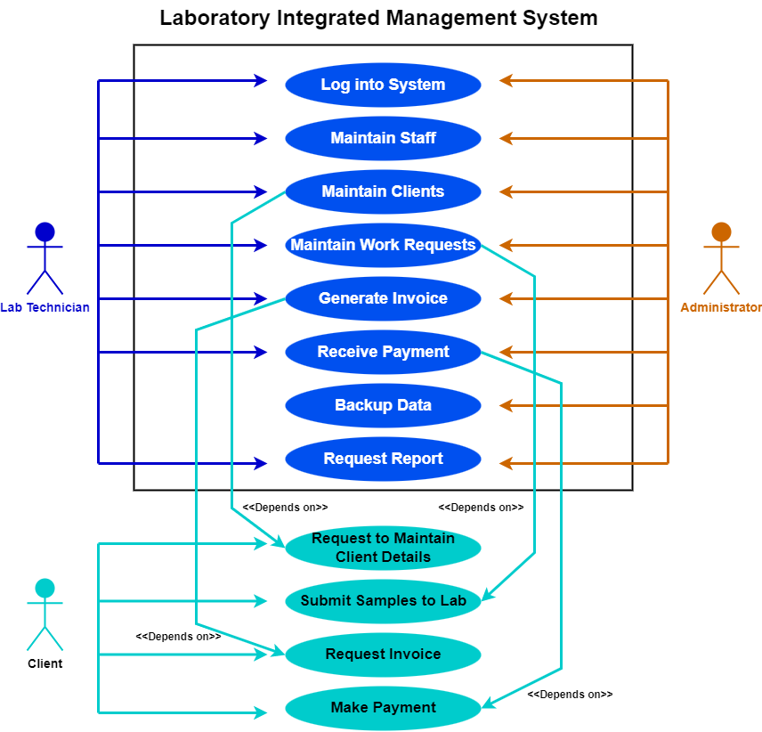
8. Use-Case Model Diagram

Slide 44
9. Examples of data, questionnaires and fact-finding techniques used
Interview:
Interviewee: Peter Spark, System owner and laboratory director
Location: UIS Analytical Services, Highveld Technopark, Centurion
Time: 12:30
Date: 18 March 2022
Reason for interview: Gain user requirements and define system problems

Slide 45
9. Examples of data, questionnaires and fact-finding techniques used (Continued)
Time Allocated | Interview Question/Action | User Response
2 min | Thank Mr. Spark for his time. State the purpose for the interview and what this information will be used for (see reason for interview). | N/A
4 min | Which system is currently implemented within your lab to keep track of staff? | The lab currently uses a pen and paper method to manually capture the information of staff and file the information of each member in a separate personnel file. The personnel files are kept in the document storage room.
4 min | Which system is currently implemented within your lab to keep track of clients? | The lab currently uses a pen and paper method to manually capture the information of clients on client information forms and file the information of each client in a separate client file. The client files are kept in the document storage room.
4 min | Which system is currently implemented within your lab to keep track of work requests? | The lab currently uses a pen and paper method to manually capture the information of new samples on a work request form. The physical copy of the work request form is handed to the responsible lab technician. Once the work request has been completed, the form is stored in the document storage room.

Slide 46
9. Examples of data, questionnaires and fact-finding techniques used (Continued)
Time Allocated | Interview Question/Action | User Response
4 min | Which system is currently implemented in your lab to perform financial functions? | Invoices are created by entering work request details into an electronic spreadsheet. Payments received are allocated to the corresponding invoice in an electronic spreadsheet that keeps track of invoices.
4 min | Would you say that the current system is easy or difficult to use, and why? | Difficult to use because the manual nature of the system makes its use both time-consuming and frustrating.
4 min | What flaw(s) are currently in the system what you would like for us to improve upon with the newly developed system? | The physical storage of records is a risk that needs to be minimized. It is difficult to obtain any overview information from the system such as which work requests are still in progress and which invoices are still unpaid. Electronic spreadsheets have to be created and maintained manually to assist with this.
4 min | If we were to develop a system for the lab, would you be willing to pay a fee for us to maintain the system? | If the fee is within reason and the lab can afford it. So long as the system meets all of the requirements and is implemented within schedule.
30 minutes

Slide 47
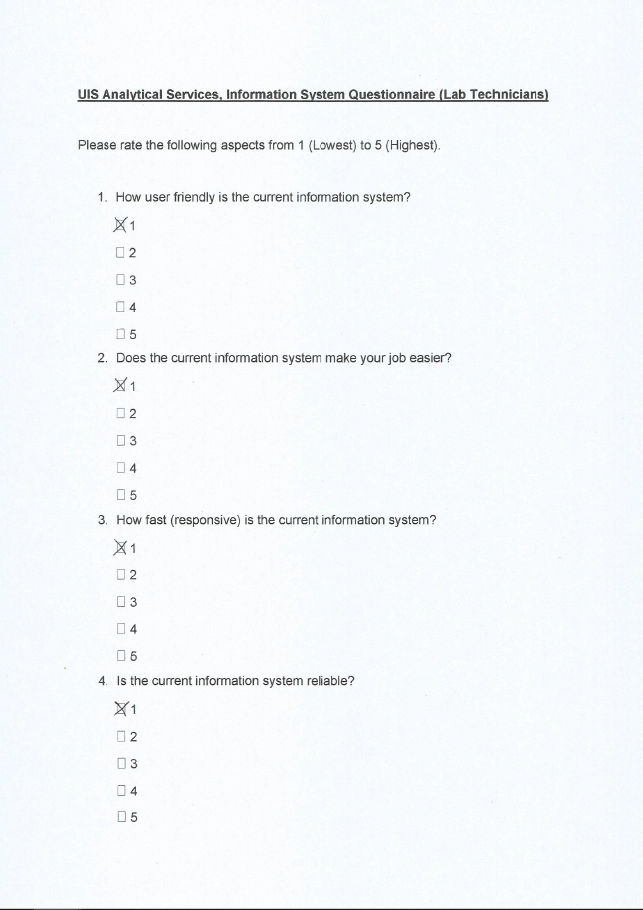
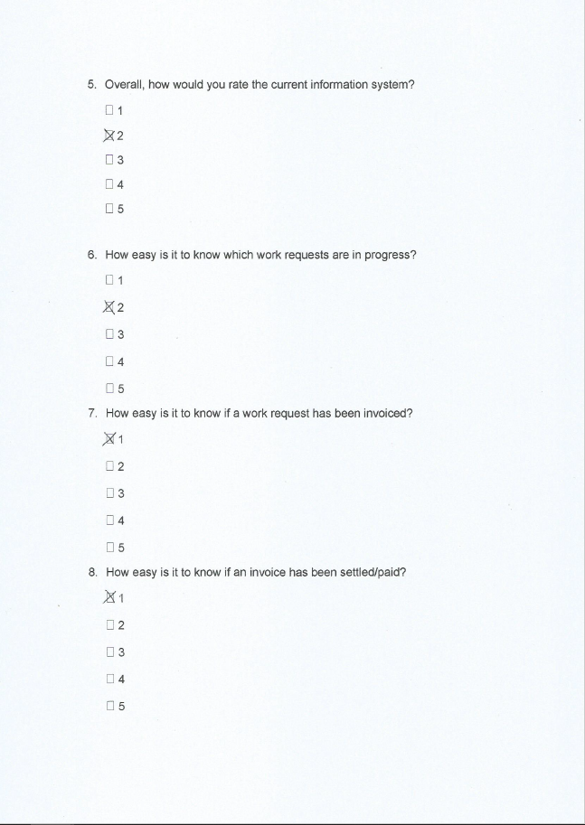
9. Examples of data, questionnaires and fact-finding techniques used (Continued)

Slide 48
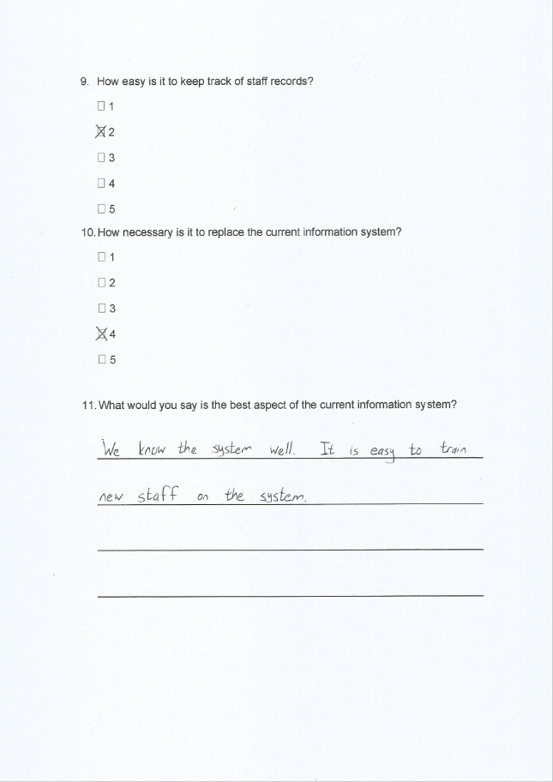

9. Examples of data, questionnaires and fact-finding techniques used (Continued)

Slide 49
9. Examples of data, questionnaires and fact-finding techniques used (Continued)
UIS Analytical Services, Information System Questionnaire (Lab Technicians)
Summary of findings.
A total of 7 lab technicians completed and returned the questionnaire.

Slide 50
9. Examples of data, questionnaires and fact-finding techniques used (Continued)
1) How user friendly is the current information system?
Answer |  |  | Count
1 |  |  | 4
2 |  |  | 2
3 |  |  | 1
4 |  |  | 0
5 |  |  | 0
2) Does the current information system make your job easier?
Answer |  |  | Count
1 |  |  | 5
2 |  |  | 2
3 |  |  | 0
4 |  |  | 0
5 |  |  | 0
3) How fast (responsive) is the current information system?
Answer |  |  | Count
1 |  |  | 6
2 |  |  | 1
3 |  |  | 0
4 |  |  | 0
5 |  |  | 0

Slide 51
9. Examples of data, questionnaires and fact-finding techniques used (Continued)
4) Is the current information system reliable?
Answer |  |  | Count
1 |  |  | 4
2 |  |  | 2
3 |  |  | 1
4 |  |  | 0
5 |  |  | 0
5) Overall, how would you rate the current information system?
Answer |  |  | Count
1 |  |  | 3
2 |  |  | 2
3 |  |  | 2
4 |  |  | 0
5 |  |  | 0
6) How easy is it to know which work requests are in progress?
Answer |  |  | Count
1 |  |  | 3
2 |  |  | 3
3 |  |  | 1
4 |  |  | 0
5 |  |  | 0

Slide 52
9. Examples of data, questionnaires and fact-finding techniques used (Continued)
7) How easy is it to know if a work request has been invoiced?
Answer |  |  | Count
1 |  |  | 4
2 |  |  | 2
3 |  |  | 1
4 |  |  | 0
5 |  |  | 0
8) How easy is it to know if an invoice has been settled/paid?
Answer |  |  | Count
1 |  |  | 5
2 |  |  | 2
3 |  |  | 0
4 |  |  | 0
5 |  |  | 0
9. How easy is it to keep track of staff records?
Answer |  |  | Count
1 |  |  | 3
2 |  |  | 2
3 |  |  | 1
4 |  |  | 1
5 |  |  | 0

Slide 53
9. Examples of data, questionnaires and fact-finding techniques used (Continued)
10) How necessary is it to replace the current information system?
Answer |  |  | Count
1 |  |  | 0
2 |  |  | 0
3 |  |  | 2
4 |  |  | 2
5 |  |  | 3
11) What would you say is the best aspect of the current information system?
Most common answer:
That everyone is already very familiar to the system, and it is easy to train new staff on the system.
12) What would you say is the worst aspect of the current information system?
Most common answer:
How frustrating it is to use.

Slide 54
Summary, future and further planning
The requirements for the laboratory was covered in this document, leading to the conclusion of the Requirements Analysis Phase for the project. The first three phases of the project have now been completed, namely the Scope Definition, Problem Analysis and the Requirements Analysis. Upon the acceptance of this Requirements document, work will begin on the Logical Design phase of the project, which is to be completed by 22 May 2022.

Slide 55
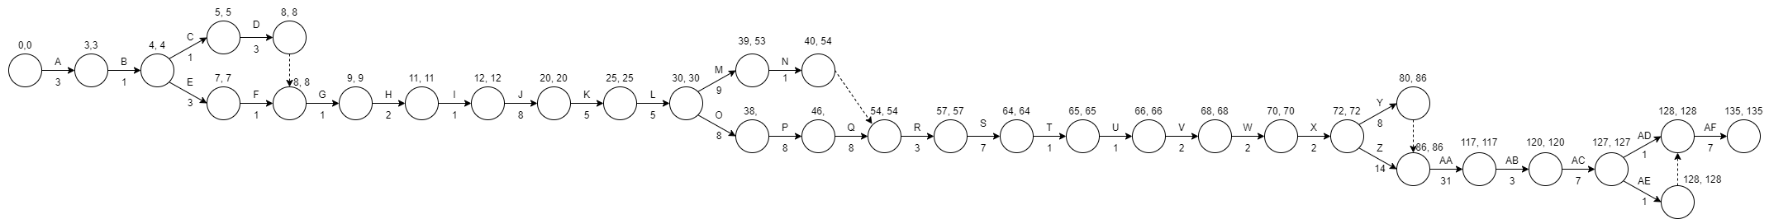
Summary, future and further planning (Pert chart)

Slide 56
Summary, future and further planning (Pert chart Glossary)
Symbol | Task
A | Feasibility assessment to identify problems, opportunities and directives
B | Negotiate scope
C | Determine the constraints of the system
D | Create the project plan
E | Analyse the existing system
F | Establish objectives for the improvement of the system
G | Update the project plan
H | Create project proposal presentation
I | Present project proposal
J | Identify the LIMS requirements by means of interviews/questionnaires
K | Analyse the system requirements
L | Prioritize business requirements
M | Update the project plan
N | Submit requirements analysis
O | Translate data and information requirements into logical data models
P | Translate business process requirements into logical process models
Q | Translate business and system interface requirements into logical interface models
R | Identify candidate solutions
S | Analyse candidate solutions
T | Recommend a candidate system
U | Submit decision analysis
V | Determine the physical database design specifications
W | Determine the software design specifications and physical business processes
X | Determine the physical user and system interface specifications
Y | Design the system as stated in the specifications
Z | Create the database for the new system
AA | Create the interfaces for the new system
AB | Debug the new system
AC | Test the new system to ensure that it is satisfactory
AD | Deliver and install the new system
AE | Provide system manual
AF | Train the system users

